Slide 1
The Heart of Drug Policy CLOSE-UP FOUNDATION March 13, 2023 Eric E. Sterling, J.D.

Slide 2
Speaker Biography
Eric E. Sterling
Lakeland H.S., Shrub Oak, NY, 1967; Haverford College, B.A., 1973; Villanova University Law School, J.D., 1976
Assistant Public Defender, Delaware County, PA ,1976-1979
Assistant Counsel, Committee on the Judiciary, Subcommittee on Crime, U.S. House of Representatives, 1979-1989, responsible for drugs, organized crime, money laundering, gun control, pornography, etc.
Executive Director, Criminal Justice Policy Foundation, 1989 – 2020
Adjunct Lecturer – American University, 1984 -1986; George Washington University, 2006 - 2008
Montgomery County, MD, Alcohol and Other Drug Abuse Advisory Council, 2008 – 2018
Maryland Medical Cannabis Commission, 2013 – 2017
Students for Sensible Drug Policy, Board of Directors, 2004-2020
CURRENT:
MONTGOMERY COUNTY, MD, POLICING ADVISORY COMMISSION
LAW ENFORCEMENT ACTION PARTNERSHIP – A spokesperson

Slide 3
America needs a new drug policy
107,000 fatal drug overdoses last year are a result of America’s drug policy
Opioids, cocaine, other stimulants and other drugs are consumed, obtained, sold, imported and produced as a result of the laws and policies we have created.
How did current drug policy develop?
What are the intellectual foundations of our current drug policy?
What are the premises of a proper drug policy?

Slide 4
Overview
Current drug policy is grounded in a historical paradigm of distrust and contempt of people
who use drugs.
An implicit policy goal is to maintain White supremacy and control “dangerous classes.”
The operational features and theoretical premises of drug policy are built on fallacies.
If you don’t use drugs, your risk of overdose is close to zero.
Drug policy should reduce the suffering and protect the lives of people who use drugs.

Slide 5
Primary goals of modern drug policy
Prevent deaths, injuries and disease among people who use drugs.
Reduce the suffering of people who use drugs problematically.
Subsidiary goals
Reduce crime.
Reduce the power and profits of criminal organizations.
Protect children.
Use public resources effectively and humanely.
Support the American system of “Liberty and Justice for All.”

Slide 6
Origins of American drug policy
Three impulses in U.S. in late 19th Century:
Address addiction of Civil War veterans to opiates
Improve trade relations with China (late 19th/early 20th century) through the control of opium trade to China. (Reverse course of the British forcing opium on China as a result of two wars, 1839-1842 and 1856-60.)
Maintain White Supremacy by controlling Chinese immigrants and freed slaves and descendants.

Slide 7
Early federal anti-drug policy
Federal narcotics control in 1914 justified by claims that Negro men using cocaine were responsible for the rape of White women in the South.
Federal marijuana control in 1937 based on claims of Negro and Mexican degeneracy.
Drug control became a law enforcement agency responsibility. Public health approaches were blocked

Slide 8
Late 20th Century “War on Drugs” continues to rely on racist fears
Early 1960s anti-drug fears focus on urban Black heroin use
Mid 1960s anti-drug fears extended to associate drug use with urban rebellions, Black power, anti-war, and social change movements including marijuana and LSD.
1970s anti-drug fears extended to “addicted” Black Vietnam veterans and teenage marijuana use.
1980s anti-drug fears extended to people injecting drugs and the spread of HIV, and the use of crack cocaine. Black men were portrayed as gangsters, Black women portrayed as abandoning their children to pursue crack addiction (so-called “boarder babies”). Hispanic men portrayed as cocaine cartel gangsters.
1990s anti-drug fears extended to Hispanic methamphetamine traffickers.

Slide 9
Early 21st Century Racist Anti-Drug Stereotypes Continue
Black Urban gangsters
Mexican cartels
Chinese producers of Fentanyl

Slide 10
Anti-drug strategy changes responded to waves of fear
President Nixon-era: Rhetoric of “crack-down,” expanded enforcement effort, e.g. creation of Drug Enforcement Administration, COINTELPRO. Contrast with brief emphasis on opioid addiction treatment with methadone.
President Carter-era: Campaigned on marijuana legalization platform but reversed position due to growing high school student marijuana use epidemic and growth of parent movement.
President Reagan-era: Partisan politicization of anti-drug policy; dramatic expansion of enforcement funding, operations and punishments. First Lady Nancy Reagan promotes “Just Say No,” DARE, and similar prevention efforts.
Presidents Bush I - Clinton-era: Focus on punishment, “user accountability,” expanded collateral consequences. Dramatic racial disparity in enforcement and imprisonment.

Slide 11
Dominant paradigm
People who use drugs do not have any autonomy and not entitled to dignity.
People who use drugs don’t belong in society with the rest of us.
People who grow or distribute drugs are depraved and vicious.
The problems surrounding the use of drugs are due to drugs, not the policies that shape the drug economy and the lives of people who use drugs.
Stopping drugs is the job of “fighters” – cops, prosecutors, judges, prisons, the military.
The problems around drugs are a national security crisis.

Slide 12
Example of the dominant paradigm
On Dec. 15, 2021, President Biden declared a national emergency regarding drugs.
Among the findings was “the deaths of tens of thousands of Americans annually as well as countless more non-fatal overdoses.”
But those deaths and overdoses were NOT the national emergency!
The “national emergency” was the threat of illicit drug trafficking.
The emergency response is directed to the Secretary of the Treasury to impose sanctions on “foreign persons.”

Slide 13
Dominant paradigm is about enforcement It’s wrong
If we punish people or threaten people, we will change their behavior.
Paradigm is psychologically invalid and inadequate.
We can’t raise our children effectively if we rely primarily on punishment.
We don’t train our pets by primarily punishing them.
Data shows that DRUG ENFORCEMENT IS FOCUSED on People of color, low-level offenders.

Slide 14
Examining the fallacies of drug policy
Effectiveness of deterrence of users
Effectiveness of deterrence of distributors
Enforcement can reduce supply
Enforcement hurts drug traffickers
It is cheaper to stop drugs at the source
We can take the profits out of drug trafficking
Exaggerating harms of use is a deterrent

Slide 15
First fallacy of drug policy: Effectiveness of deterrence of users
Theoretical basis for punishment of users is belief in deterrence.
Deterrence is only effective if the target believes the likelihood of the punishment is unacceptably high. This conflicts with reality:
A. Only a tiny fraction of people who use drugs are caught. Risk is too low to serve as deterrent.
B. Person with severe substance use disorder is not typically engaged in cost-benefit analysis.
Even if apprehended, deterrence of continuing to use is frequently undermined in practice by the typical probation drug use monitoring programs that frequently ignore some number of positive urine screens.
Hawaii’s Opportunity Probation with Enforcement (HOPE Probation) is an exception because risk of being caught is high and short-term punishment is likely.

Slide 16
Second fallacy of drug policy: Effectiveness of deterrence of distributors
Theoretical basis for punishment of producers/traffickers is deterrence.
Deterrence only effective if the target believes likelihood of the punishment is unacceptably high.
A. Only a tiny fraction of producers and distributors are caught. Risk is too low to serve as deterrent, if they engage in a cost-benefit analysis.
B. Many low-level distributors and producers have no better economic alternative to make a livelihood.
C. Many low-level distributors have substance use disorders and distribute to meet their own needs.
D. Most persons in the throes of severe substance use disorder are too short-term focused to engage in cost-benefit analysis that considers the risk of a long sentence.

Slide 17
Illustration of fallacy: U.S. established death penalty for drug traffickers in 1994
Death Penalty – 18 U.S.C. 3591(b)(1) for engaging in a “continuing criminal enterprise” involving at least these quantities of a ”detectable amount” these drugs
(a kilogram (kg) is 2.2 pounds)
Heroin 60. kg
Powder cocaine or coca leaves 300. kg
Crack cocaine 16.8 kg
PCP (phencyclidine) 60. kg (6.0 kg (pure)
LSD 0.6 kg
Fentanyl 24. kg
Methamphetamine 30. kg (3.0 kg pure)
Marijuana 60,000. kg or 60,000 plants
THESE SENTENCES HAVE NEVER BEEN IMPOSED.

Slide 18
Third fallacy of U.S. drug policy: Enforcement can reduce supply
Premise: If price goes up too high, people who use drugs won’t be able to afford them and will enter treatment or quit.
Enforcement against production and distribution creates risk and does drive up price to cover risk. Goal is to create scarcity, but scarcity is rarely created.
Increased prices means increased profits and rewards, attracts new entrants into the activity. More competition drives puts downward pressure on prices.
In places of poverty and lack of opportunity, the drug business is attractive economic activity.
A. Low barrier to entry
B. Rate of return is greater for illegal drugs than that of any legal alternative enterprise or crop

Slide 19
Fourth fallacy of drug policy: Enforcement hurts drug traffickers
Enforcement cannot be carried out at a scale that creates sufficient deterrence or to raise prices to levels that drive consumers from the market.
Drug enforcement that is carried out removes the least cunning, least effective, least disciplined, least ruthless actors from the market, thus improving the overall quality of drug traffickers.
Drug enforcement operates as price support mechanism for drugs. Drug enforcement increases the rewards for being a drug trafficker.
Inexpensive drug raw materials (plants like marijuana, coca and opium or chemical precursors) are made much more profitable by prohibition.

Slide 20
Fifth fallacy of drug policy: It is cheaper to stop drugs at the source
Members of Congress and other drug policy architects repeatedly argue that stopping cocaine or heroin at the source, i.e., in the field as coca or opium poppy, is cheaper and more effective than trying to seize finished drugs close to the point of distribution.
Hundreds of millions of U.S. dollars are spent annually on crop control programs.
But the price of coca leaf or opium gum is only a tiny fraction of the retail cost of cocaine or heroin.
Doubling or tripling the price of coca leaf or opium gum has little impact on the wholesale or retail prices of finished cocaine or heroin.
Actual global production of cocaine and opium and fentanyl has grown dramatically!

Slide 21
Sixth fallacy of drug policy: We can take the profits out
The value of total seizures of drug proceeds has never amounted to more than a few percent of total revenue obtained by drug traffickers.
Asset seizure is a less serious economic “bite” than a sales tax.
Money laundering regulations and investigations do little to reduce profits.
Tools of modern capitalism ensure that money laundering of profits is easier to carry out than to detect.

Slide 22
Seventh fallacy of drug policy: Exaggerating harms of use is a deterrent
Drug use can be extremely harmful. Exaggeration is not helpful.
The level, now, of 100,000 illicit drug fatalities annually demonstrates there are real hazards.
Psychologists who interpret drug use self-reporting data have argued that the perception of harmfulness of use of a drug influences the rate of use. If drug use is perceived as more harmful, use then declines.
Section 4125(a)(1) of the Anti-Drug Abuse Act of 1986 provided that drug and alcohol prevention and education programs and activities include “school drug abuse education and prevention curricula which clearly and consistently teach that illicit drug use is wrong and harmful”
But danger and riskiness are very attractive to the populations at greatest risk for experimentation.

Slide 23
D.A.R.E. program exaggerated harms of drug use resulted in increased use
The 1980s and 1990s were periods of high levels of anti-drug propaganda.
One of the most common programs, Drug Abuse Resistance Education (D.A.R.E.), taught by police officers, focused on the harmfulness of drugs, often exaggerating harms. The harmfulness of marijuana was most frequently exaggerated, in part by falsely claiming that use of marijuana led to use of heroin, cocaine and LSD.
D.A.R.E. participants, in several evaluations, were more likely to use drugs than matched control students who did not participate. Other evaluations found no decreased drug use.

Slide 24
Distinguishing “risky” and “harmful”
Focusing on maximal “harmfulness” does not put risks in context, disregards potential benefits, and is inherently exaggerating.
Many common activities have a risk of death and many people are killed in these activities every year: bicycling, playing many competitive sports (such as football, soccer, lacrosse, hockey), skiing, sky diving, scuba diving, automobile racing, white water canoeing, mountain climbing, etc.
What is the “benefit” of these “non-productive,” recreational activities? Exercise, excitement, sense of self mastery, feelings of the sublime, feelings of accomplishment and success, fun,
Harmfulness focus frequently disregards or discounts potential benefits.
Youth have alternative sources of information and keen B.S. detectors
Some youth will find the “wrong and harmful” message a challenge and attraction
Accurate data on the numbers of deaths and other risks from use of drugs deters some people from experimenting with or using drugs.
But the decision to try a drug is rarely a careful cost-benefit analysis

Slide 25
A heart-based drug policy focuses on people who use drugs. What do people who use drugs need?
Nutrition
Housing
Safety
Community
Protection from contaminated and impure drugs of uncertain origin and dosage
Protection from criminals and predators
Access to appropriate health care, including mental health
Access to treatment for substance use disorders when desired

Slide 26
What does our drug policy offer people who use drugs?
Denied Supplemental Nutrition Assistance Program (SNAP) benefits if convicted of drug offense.
Denied or evicted from public housing, under the “one strike and you’re out” law.
Fired from work, expelled from school.
Arrested because they are breaking the drug law. Branded as “criminal.” Encounters with law enforcement officers can be dangerous, humiliating and traumatic.
Imprisonment, with exposure to the violence and disease endemic in prisons and jails.
Reliance on criminals to provide drugs to them – risks from dangerous manufacturing, and criminal encounters.
Excluded from health insurance and the health care system.
Shunned and treated with contempt and suspicion by health providers and others.

Slide 27
Drug policy magnifies the suffering of people who use drugs and their families
An old theory of addiction treatment was ”an addict won’t quit until they hit their bottom.”
Drug policy is organized to push people who use drugs down to “their bottom.”
In origin and evolution of drug policy the well-being of the person who uses drugs was not a primary concern.

Slide 28
Anecdote about attitudes toward people who use drugs
Early 1980s. Members of the U.S. House of Representatives, Select Committee on Narcotics Abuse and Control, are being briefed on AIDS/HIV.
Epidemiologists are reporting that persons injecting heroin had been sharing syringes and HIV was spreading among them.
A Member of Congress suddenly sits up with an insight,
“This is going to solve the heroin problem!”

Slide 29
Next Section: Looking at the Drug Problem and Drug Economy
Numbers of Persons who use Drugs
Summary of major drug problems
Causes of Fatalities
Features of Substance Use Disorder
Disruptions of life due to Substance Use Disorder
Impoverishment of heavy drug users
Punishment of drug users
Drugs and crime connection: CASH, VIOLENCE
Scope of incarceration
Racial disparity in enforcement

Slide 30
How many people used what drugs in 2020?
Numbers of Americans (12 years +) illegally used drugs, 2020 (millions, approximate)
N = ~277 million persons
Past year Past Month
Cocaine (stimulant) 5.2 1.8
Heroin (depressant) .9 .5
Opioids as a class 9.5 2.9
Methamphetamine (stimulant) 2.6 1.7
Benzodiazepines (tranquilizer) 4.8 --
Psychedelic materials --
(LSD, peyote/mescaline, mushrooms/psilocybin, etc.) 7.1 1.8
Marijuana 49.6 32.8

Slide 31
America’s Major Drug Problems
Fatalities from poisonings and overdoses
Disrupted lives due to substance use disorders
Impoverishment and social exclusion of drug users
Crime, violence and corruption in illegal drug business
Drug user crime to buy expensive drugs; also threatens neighborhoods
Neighborhoods threatened by drug business crime, primarily violence
Stigma associated with drug use and substance use disorder
Racism implicit in conceptions of addiction and drug use
Expenditures for enforcement and incarceration and collateral consequences

Slide 32
Causes of drug fatalities
Ignorance about using drugs in combinations such as alcohol and opioids
Ignorance about TOLERANCE
Repeated use of narcotics creates “tolerance.” A given quantity no longer produces the effect that it once did.
User cannot know if reduced effect is due to lower potency of a given dosage or their increased tolerance.
Uncertainty about degree of one’s tolerance and potency of dosage at each instance of ingestion
Unreliability of “dosage” quantity and purity due to illegal and shoddy sourcing
Widespread contamination of drug supply with dangerous and unexpected ingredients.
e.g., cocaine adulterated with fentanyl
Incarceration or drug treatment rapidly reduces tolerance.
Risk of overdose dramatically higher after release from custody or treatment upon relapse, because of lost tolerance. Upon release corrections authorities and treatment programs do not provide naloxone or overdose prevention training.
Lack of training in self-protective techniques
Isolation of drug users – use alone or in remote places

Slide 33
Features of a substance use disorder
Inability to feel well or normal or function normally without another dose of a substance
Inability to stop use of a substance when use is causing problems
Inability to maintain control in the use of a substance
Preoccupation with obtaining drugs and the money to get drugs

Slide 34
Disruption of life due to substance use disorder
Students distracted from studying; school failure
Athletes unable to continue to perform at high level
Workers unable to function properly
Family members in conflict with others

Slide 35
Drug policy impoverishes people who are heavy users of drugs
Drug users get arrested and criminal records. Lose jobs, can’t get hired, can’t get paid. Can’t afford food. Can’t pay rent.
Drug sellers are arrested and drugs are seized in order to create scarcity in order to drive up the price. Rationale is high prices make drugs unaffordable.
Increased retail price of drugs has been a measure of effectiveness of drug enforcement.
Thus, drug users have to pay a lot to buy their drugs.
Making people more desperate may encourage them to get medical care and drug treatment but this comes at an enormous cost to their safety and dignity.
More homeless, unemployed drug users in the neighborhood is not good for the neighborhood either.

Slide 36
Drug use is a crime in every state*
Person with a substance use disorder who uses an illegal drug daily, is a criminal all day long.
The possession of drugs is a crime subject to arrest, fine and imprisonment in every state except Oregon.
The penalties for simple possession of addictive drugs like heroin, cocaine, methamphetamine, fentanyl, barbiturates, etc. usually carry prison terms at one year, and often more, and fines of thousands of dollars.
The penalties for possession of drugs are often greater than the penalties for crimes like prostitution, shoplifting, petty theft. Repeat penalties can be as great as penalties imposed for burglary and fraud.

Slide 37
The most severely addicted are punished more harshly
In most states and Federal law, repeated violations of the possession prohibition incur longer and longer sentences.
But repeated violations of possession indicates a more severe substance use disorder and that the person is less responsive to treatment.
Substance use disorders are diagnosable diseases. Is it just to punish people for behavior that is characteristic of a disease and that does not hurt others?
A person with a more severe addiction will find it harder to quit and is more likely to relapse. Relapse means using drugs again. If caught they will be punished more severely.
This is patently cruel, but perfectly illustrates the drug policy paradigm.

Slide 38
Prohibition creates the drugs and crime connection
People who use drugs are forced into unemployment and homelessness.
People who use drugs need to find the money to live and pay for expensive drugs.
Punishments for property crimes are often less than penalties for possession of drugs.
Person who uses drugs forced to self-identify as “outlaw,” “law-breaker,” ”criminal.”
Note, the use of drugs by itself does not create any desire or inclination to commit crime.
With the social and economic structure created by drug prohibition, having a substance use disorder means remunerative crime (to make money) becomes necessary and logical.
Heroin and cocaine are refined agricultural products like sugar or cocoa. They are cheap to produce or transport. They are expensive because they are illegal.

Slide 39
Because drugs are illegal they can only be purchased for CASH
CASH DRIVES VIOLENCE
Cash is a target for robbers.
Cash is tempting for employees to try to embezzle.
Illegal drug sellers cannot hire off-duty police or licensed private security services.
Illegal drug sellers hire their own gun-toting security.
A greater reputation for violence is better to deter robbery or disloyalty.
CASH DRIVES CORRUPTION
Lots of cash needs to be “laundered” – you can’t buy a house or a car with cash, etc.
Money laundering requires corrupting banks, creating false corporations, and bogus economic activity.
A constant supply of cash makes illegal payoffs and corruption easier.

Slide 40
Managing an illegal drug business requires violence
Very low barrier to entry.
Very high return on investment at all levels.
All cash business has high robbery risk. Drug seller can’t report robbery to law enforcement for investigation or justice. Drug dealer security requires credible threat of violence.
Law enforcement’s surveillance & wiretapping leads to coded communications regarding transactions.
Everyone arrested is encourage to inform against partners. Violent retribution is the primary protection against partners becoming informants.
Advancement in the business is very threatening and dangerous.
Drug dealer conflict excluded from legal dispute resolution like courts.
Violence is the remedy against thieves, informants, business rivals, competitors.

Slide 41
Drug policy leads to abandoned neighborhoods
Impoverishment of drug users leads to homelessness.
Drug laws requiring the eviction of drug users leads to homelessness.
Homeless drug users and illegal drug markets co-locate.
Unemployed drug users panhandle, engage in prostitution, petty theft in their immediate area.
Neighborhood downward spiral caused by or aggravated by drug policy.
Additional housing and businesses abandoned.
Redevelopment and investment in crime-filled neighborhoods is more risky and less likely to be profitable.
Tax burden increases on others.

Slide 42
Huge expenditure on mass incarceration
Approximately one-seventh of those in state prisons are serving a sentence for drug distribution or drug possession (2018), at a cost of $7.9 billion (2019).
A large fraction of those in prison have parole or probation revoked because of a drug relapse.
Of those in prison, estimates are that between two-thirds and 80 had substance use disorders or were under the influence of drugs and/or alcohol at the time of the offense. Many were stealing to support themselves and to purchase their drugs.
Most persons in prison with substance use disorders do not get any treatment.
Total state prison expenditures, $56.6 billion (2019)

Slide 43
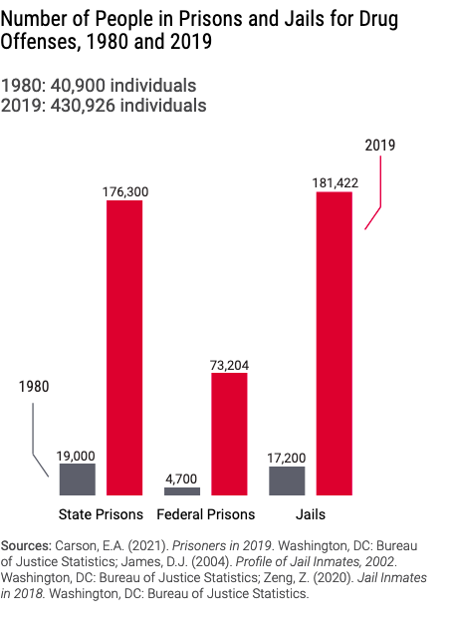
430,926 drug offenders incarcerated in U.S. 2019 Data from The Sentencing Project, May 2021, “Factsheet: Trends in U.S. Corrections”

Slide 44
Contemplating the scale of U.S. incarceration
Imagine every U.S. state as an independent nation.
Let’s look at the incarceration rates of all the nations and the U.S. states
24 states would have the highest incarceration rate in the world — higher even than the United States.
Massachusetts, the state with the lowest incarceration rate in the nation, would rank 17th in the world with an incarceration rate higher than Iran, Colombia, and all the founding NATO nations.
Our drug policy has relied on incarceration.

Slide 45
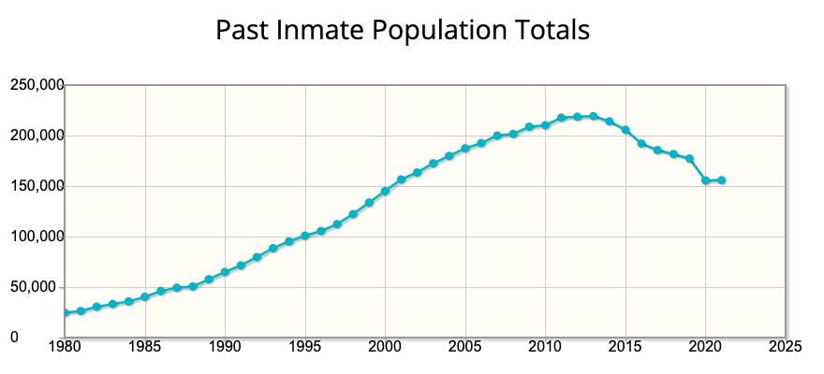
New anti-drug laws drove imprisonment growth for 35 years, Federal Prison Population FY1980-FY2021

Slide 46
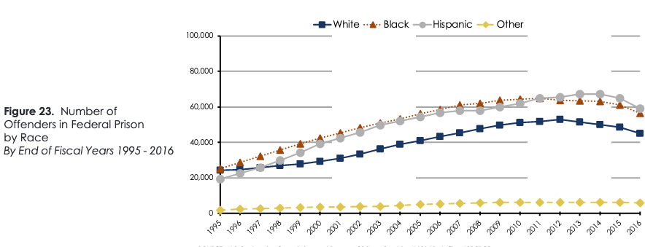
Drug enforcement drives growing Racial disparity in Federal Prison 1995-2016

Slide 47
Federal Crack – Powder Disparity
1986 Anti-Drug Abuse Act:
Minimum five years triggered by: 2010 amendment
500 g cocaine powder 5 g cocaine base (“crack”) > > > 28 g
(more than a pound) Weight of a nickel ($0.05 coin)
Minimum ten years triggered by: 2010 amendment
5000 g cocaine powder 50 g cocaine base (“crack”) > > > 280 g
12 lbs. Weight of an average candy bar
In 1990s, crack prosecutions dominate federal drug enforcement
Crack traffickers much lower-level traffickers than powder traffickers: Less money; small quantity

Slide 48
Huge unwarranted racial disparity in Federal crack prosecutions
Roughly two-thirds of people who use crack are White.
Most sellers of crack are White.
FY 1992- FY2020, 113,414 federal crack distribution convictions. In 23 years, in only 5 years was the percentage Black convictions less than 80% of the total (Low was 76.8% in 2020). In only 6 years was the White percentage more than 8% of total. (High was 10.4% in 2008)
Federal Black crack defendants now outnumber White crack defendants by about 12 to 1 ratio,
FY 2020, Blacks 76.8% of crack convictions; Whites 6.3%

Slide 49
For the last 50 years we have pursued the wrong response to substance use disorders: drug enforcement

Slide 50
If we want to save the lives of people who use drugs,
then we must be committed to the welfare of people who use drugs.

Slide 51
Biden Administration moving to modern policy
Biden’s Office of National Drug Control Policy (ONDCP) adopts Harm Reduction agenda April 2021
HHS Secretary Xavier Becerra told NPR, Oct. 21, 2021, they won’t block Safe Consumption Sites (position later walked back by HHS spokespersons; SCS still opposed by Justice Department)
Nora Volkow, M.D., head of National Institute on Drug Abuse since 2003, calls for “decriminalization” of all drugs in Spring 2021.
ONDCP proposing model law for states to expand naloxone distribution to reverse overdoses on the street, Nov. 17, 2021
CDC says federal money can be used to buy fentanyl test strips, April 7, 2021

Slide 52
Harm Reduction finally being accepted
Syringe Services – Adopted in many states
Stop spread of disease; connect people who use drugs with health services
Naloxone distribution and training for street use
Provide naloxone widely to family, friends of illegal drug users
Enhance effectiveness by providing naloxone with all opioid prescriptions
Overdose Prevention and Safe Consumption Sites –
Insite -- Vancouver, British Columbia
No known overdose fatalities in 100s of thousands of injections.
Two sites open in New York City 2021
President Biden embraces Harm Reduction in State of the Union address, March 1, 2022.

Slide 53
The Heart of Drug Policy
In your heart, there is compassion for the people in treatment and recovery
Anyone in recovery lives with a risk that they might relapse – it’s the nature of the disease.
Anyone who relapses deserves our complete compassion and support. They are not “bad” and don’t deserve punishment
People who have relapsed are not different from people who have never entered treatment.
All people who are using drugs are ALWAYS at risk from drug prohibition policies.
The heart of drug policy is in each of our hearts!

Slide 54
Speaker Contact
Eric E. Sterling, J.D.
eric.sterling@gmail.com
202-365-2420

